Slide 1

IIT Bombay
DS-203
E-11

Slide 2
DS203
Team members
Rishu Kuamr
Khushajh Verma
Ayush Jadia
Roll Number: 22B2130
Roll Number: 22B2128
Roll Number: 22B0407
Branch : Mechanical
Branch : Mechanical
Branch : Mechanical

Slide 3
Description of Data
EDA & Data Preparation
Agenda
ML Model & Solutions
Conclusion

Slide 4
Description of Data
Source of Data | Daily averaged values of observations logged by a data acquisition system at a chemical processing plant
About Data | Data Contains 240 columns representing various parameters monitored and/or controlled. Also contains a column having timestamps that span over 2 years and 9 months
Problems in Data | Many columns contain cells filled with different types of non-numerical character empty spaces that basically show missing value

Slide 5
EDA and Preparation of Data
Cleaning of Data
With -999 just to make uniformity in data. So that we can handle easily
Drop Columns
Having more than 70% of cells filled with -999. Since those will not help in our analysis
Any type of non-numeric character
Replace
Result
Replace any -999 in the remaining column with the median of that column (excluding -999 in the calculation
Imputing
Dropped columns = [ ‘c226’, ‘c190’, ‘c199’, ‘c189’, ‘c229’, ‘c188’, ‘c206’, ‘c204’, ‘c202’ ]
-999 is just a random choice because there is no data having such a high magnitude with a negative sign
We do not consider 0 as an un relevant value because in our data 0 may have significance in that equipment can show 0 as a value and controllable parameters also can be 0
We put the column having 30% data and decide to impute rather than delete. Because it may be 30% can also give us some information
We use the median in place of the mean because the mean is outlier-sensitive. It may increase outlier in our data

Slide 6
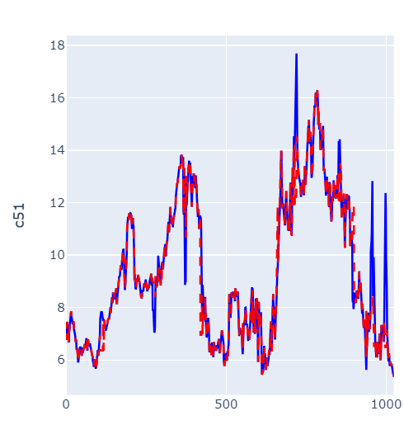
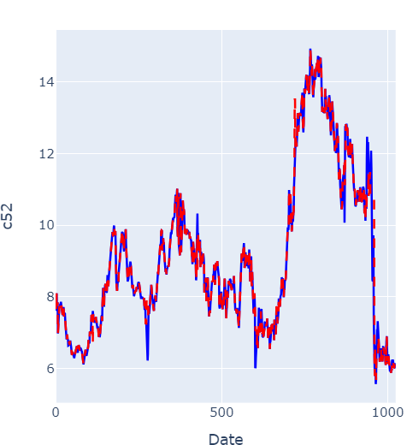
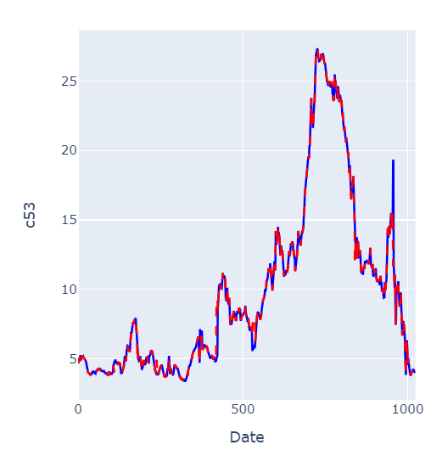
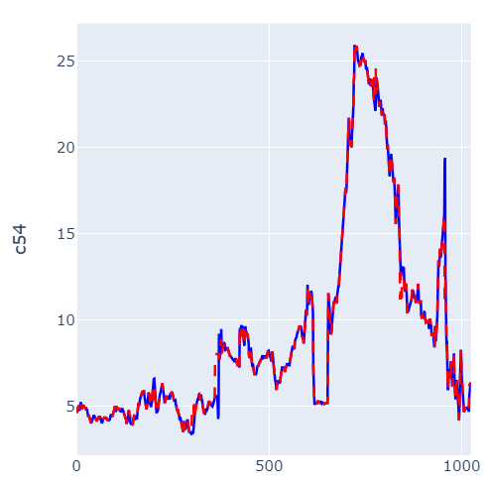


Fixing outlier
In each column while calculating outliers we used to keep the step size at 60.
While calculating IQR we used the threshold as 1.0
We fixed the step size as 60 and the threshold as 1.0 by trying manually and observing the graph
In all graphs red shows outlier fixed data and blue shows real data for features c51, c52, c53, and c54
Replace outliers with the mean of the data within the specified step size, excluding the outlier from the mean calculation

Slide 7
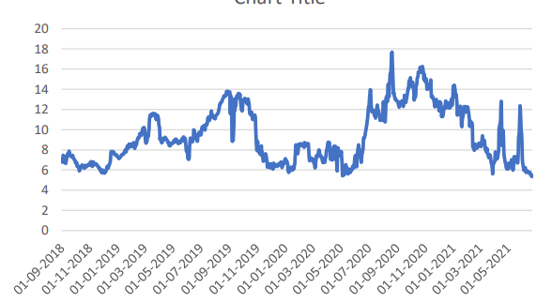
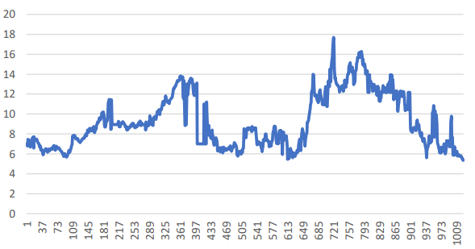
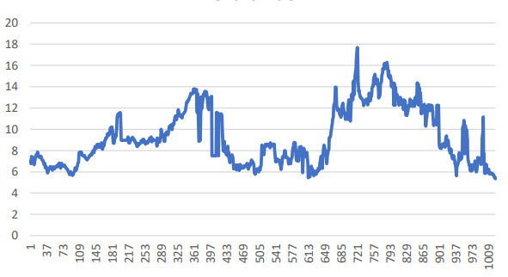
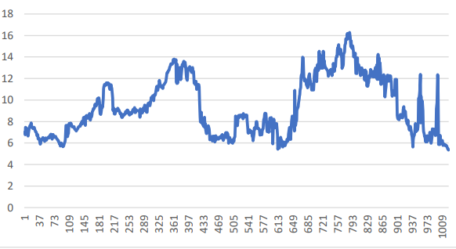
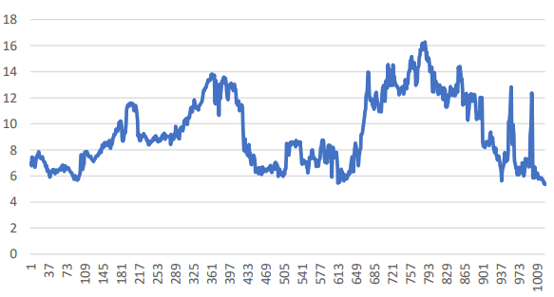
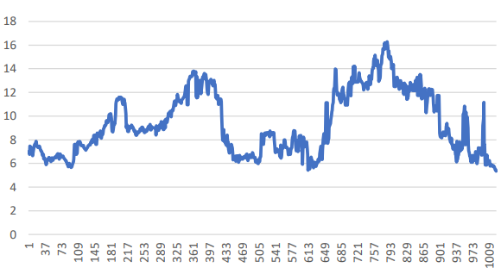
Some manual try for fixing outliers:
C51 real data
C51 step size =100, threshold =1.3
C51 step size =100, threshold =1.5
C51 step size =50, threshold =1.3
C51 step size =50, threshold =1.5
C51 step size =50, threshold =1
We put here the manual try that we did on c51 but we also did it on c52, c53, c54. But for c52 graph follows the same pattern as c51. For c53 and c54 we do not observe much change while doing trial

Slide 8
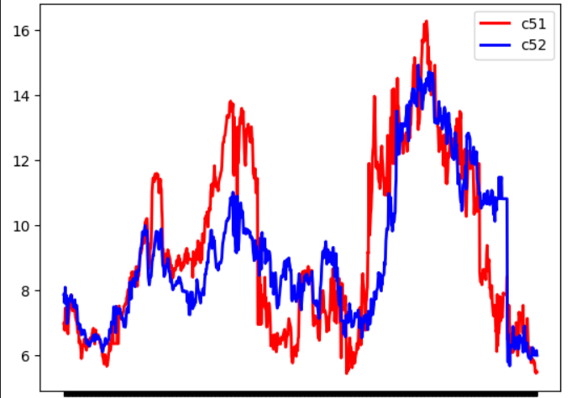
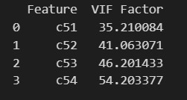
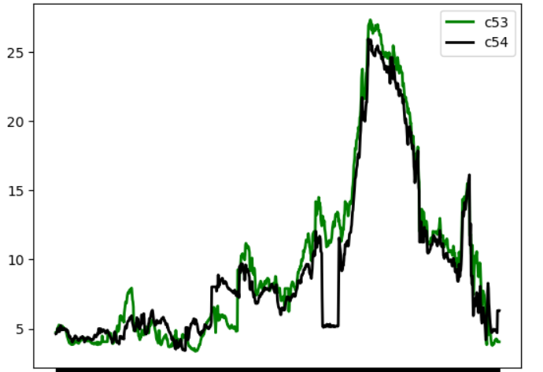
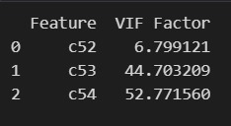

TASK 1 (PART-1)
C51, c52, c53 and c54 were plotted for visual inspection
The graph showed that c51 and c52 are related while c53 and c54 are related
This was further confirmed by VIF analysis
Hence, we made models only for c51 and c53
We formed a model between these 4 variables -
Since all of them have high VIF values, there is a high correlation.
To investigate further we remove c51 from the model to find c53 and c54 are related to each other as their VIFs are greater than 10.
Further on removing c53 we can conclude that c52 and c54 are unrelated as their VIFs are less than 10.

Slide 9
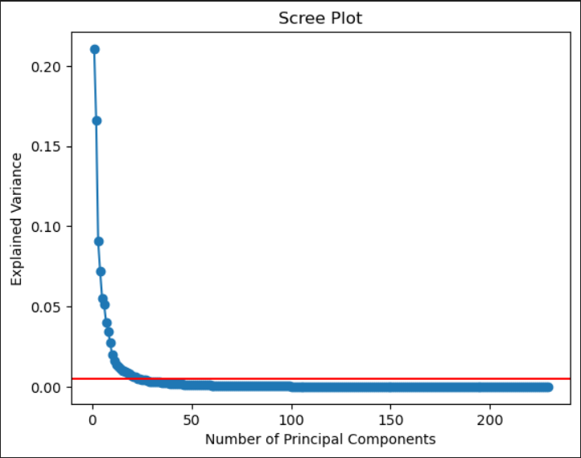
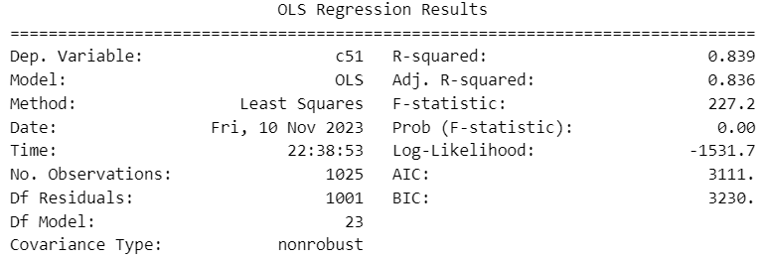
Model for c51
We normalized the data and applied the principal component analysis to the dataset.
We plotted the proportion of explained variance vs the number of components.
A threshold was set at the elbow and all points explaining a larger proportion of variance were retained while the remaining features were eliminated.
This was followed by the usual training of the model on 80% of the data and training it on the remaining 20%
We were satisfied with the model as R² in both cases nearly matched and was reasonably close to one.
Then the model was trained using the entire dataset available for which we analyzed the p-values and the R².
All p-values were below 0.05

Slide 10
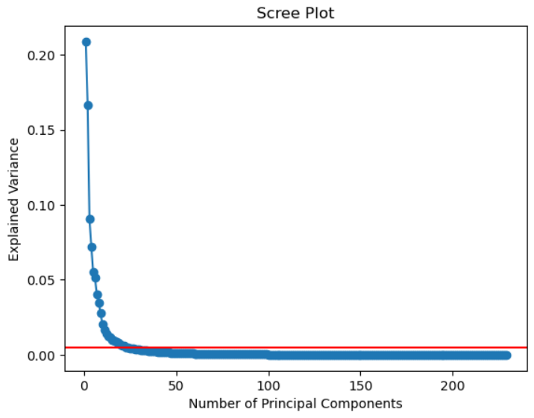
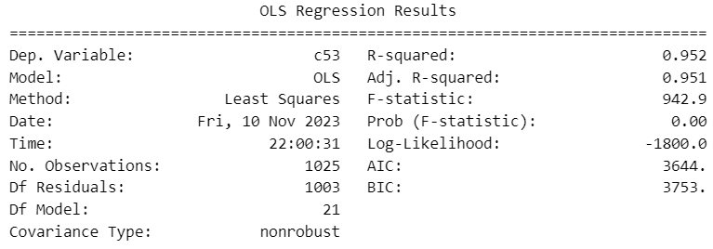
Model for c53
The same process as c51 was followed.
But in the final model, two features had p-values greater than 0.05.
These two features were eliminated one by one.
NOTE:
For any set of values of the features, if we want to predict c51/c53, we will first have to transform the data using the same set of rules as the training dataset was transformed.

Slide 11
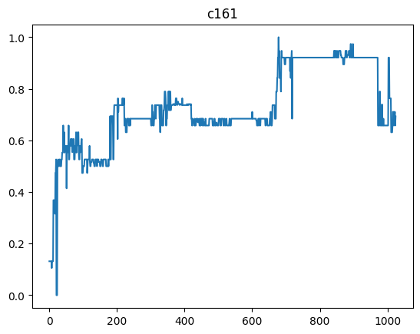
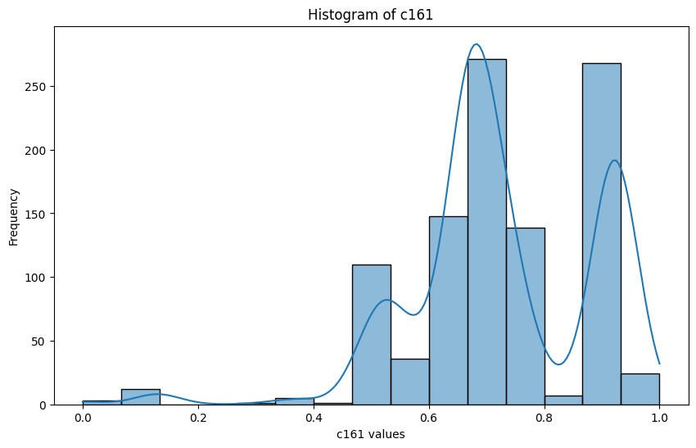
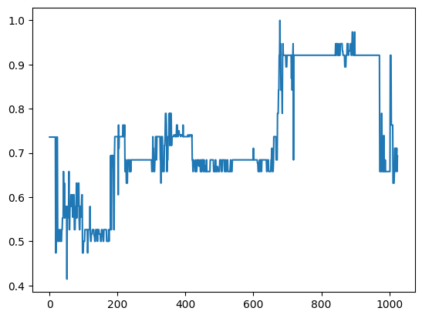
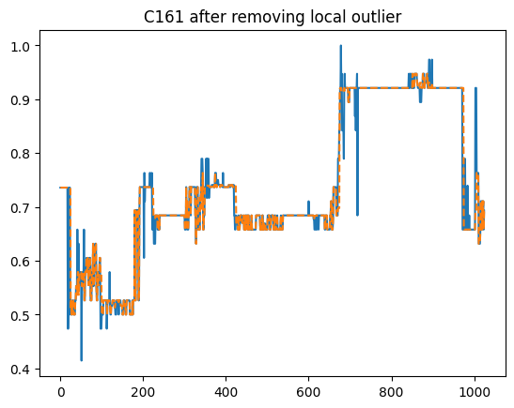
Task 1 (part-2)
As the features do not seem to have the same scales, we normalise the features before applying any model.
Now while applying the model, we saw that some of the features still had outliers that heavily affected the predicted value and thus reduced model performance. We identified those features with the help of the graphs, and the features came out to be [‘c161’, ‘c158’, ‘c30’].
To clean their data, we followed 2 simple steps:
Removing the global outliers that we identify using histograms.
Removing local outliers by manipulating the threshold value in the IQR method.
Below is an example of the C161 column:
Initial value of c161 column after normalisation
It’s clear from the histogram that values less than 0.4 are global outliers.
C161 after removing global outliers
C161 after removing both global outliers and local outliers

Slide 12
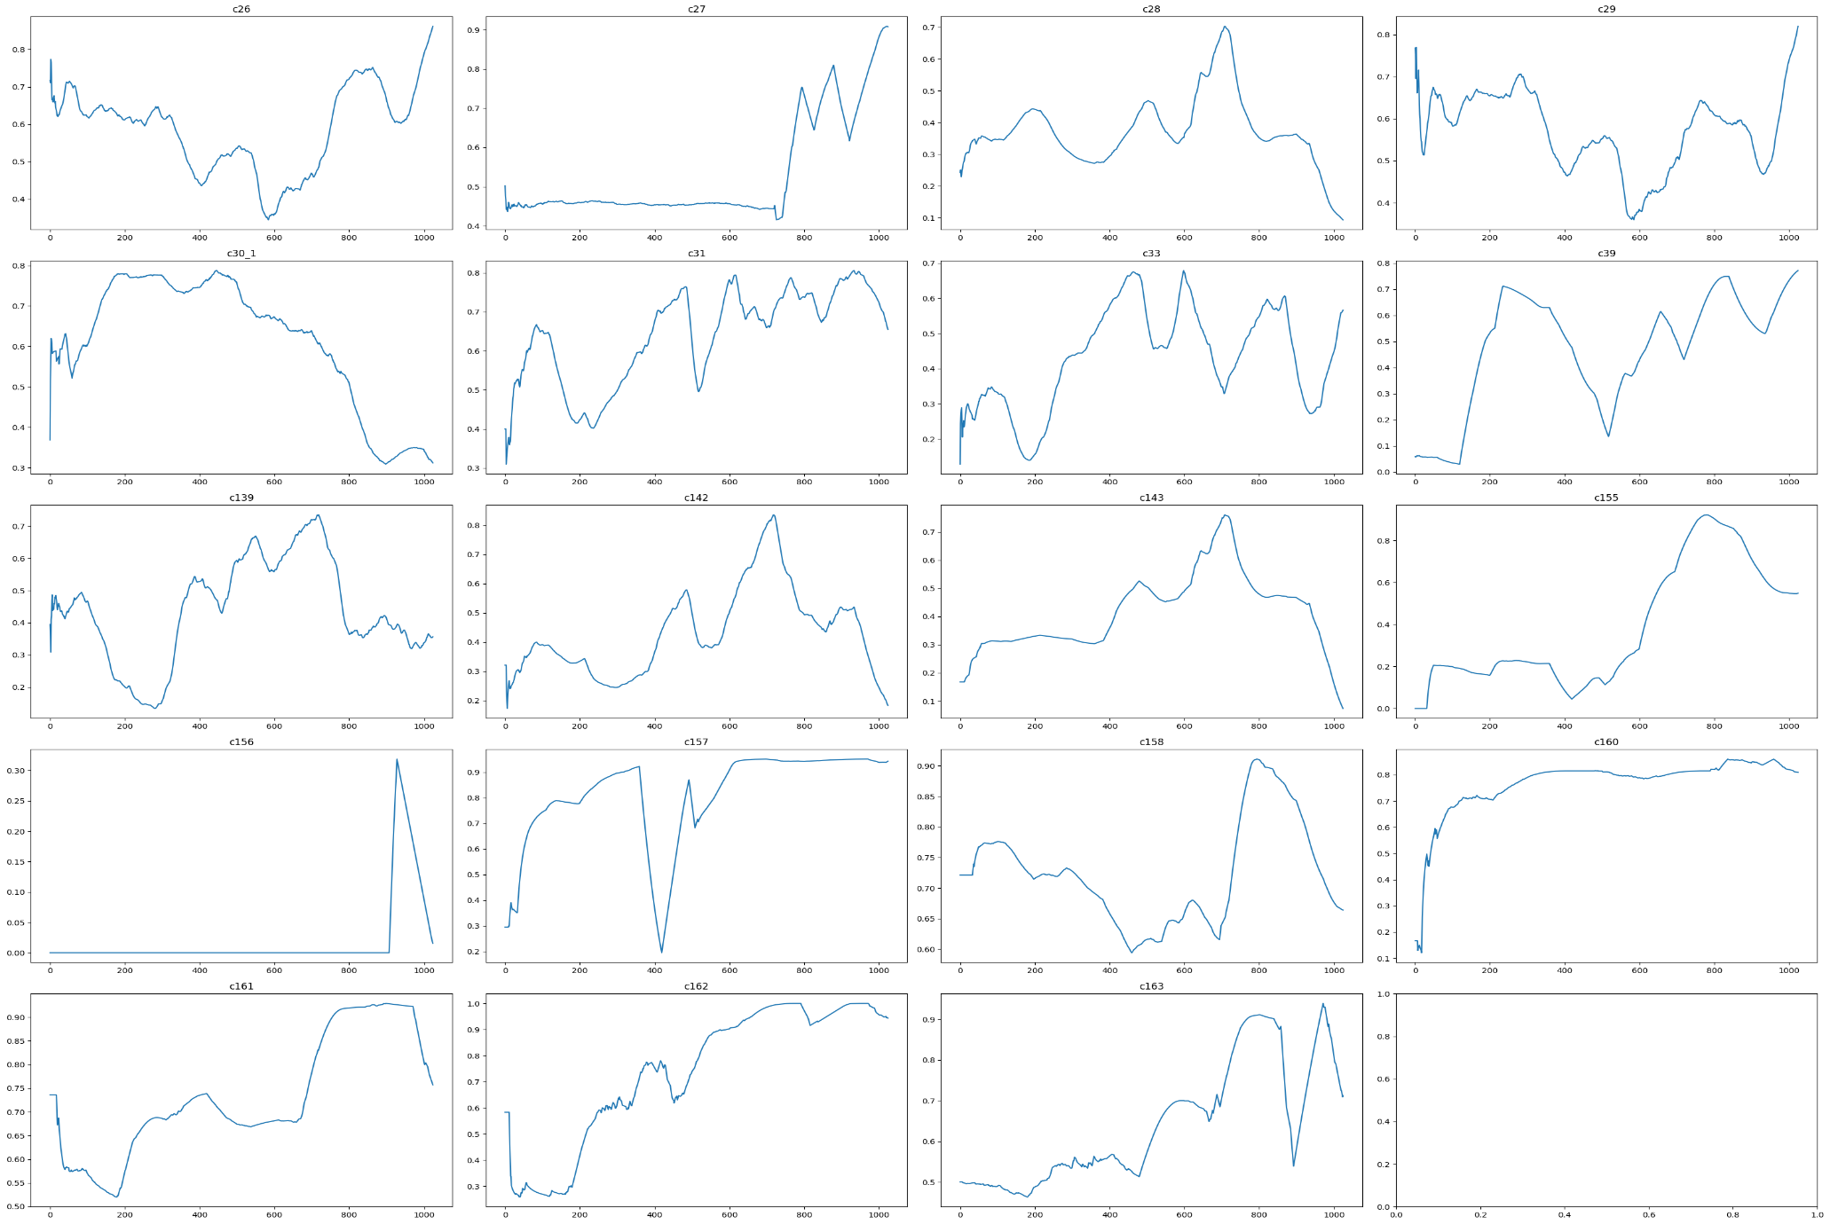
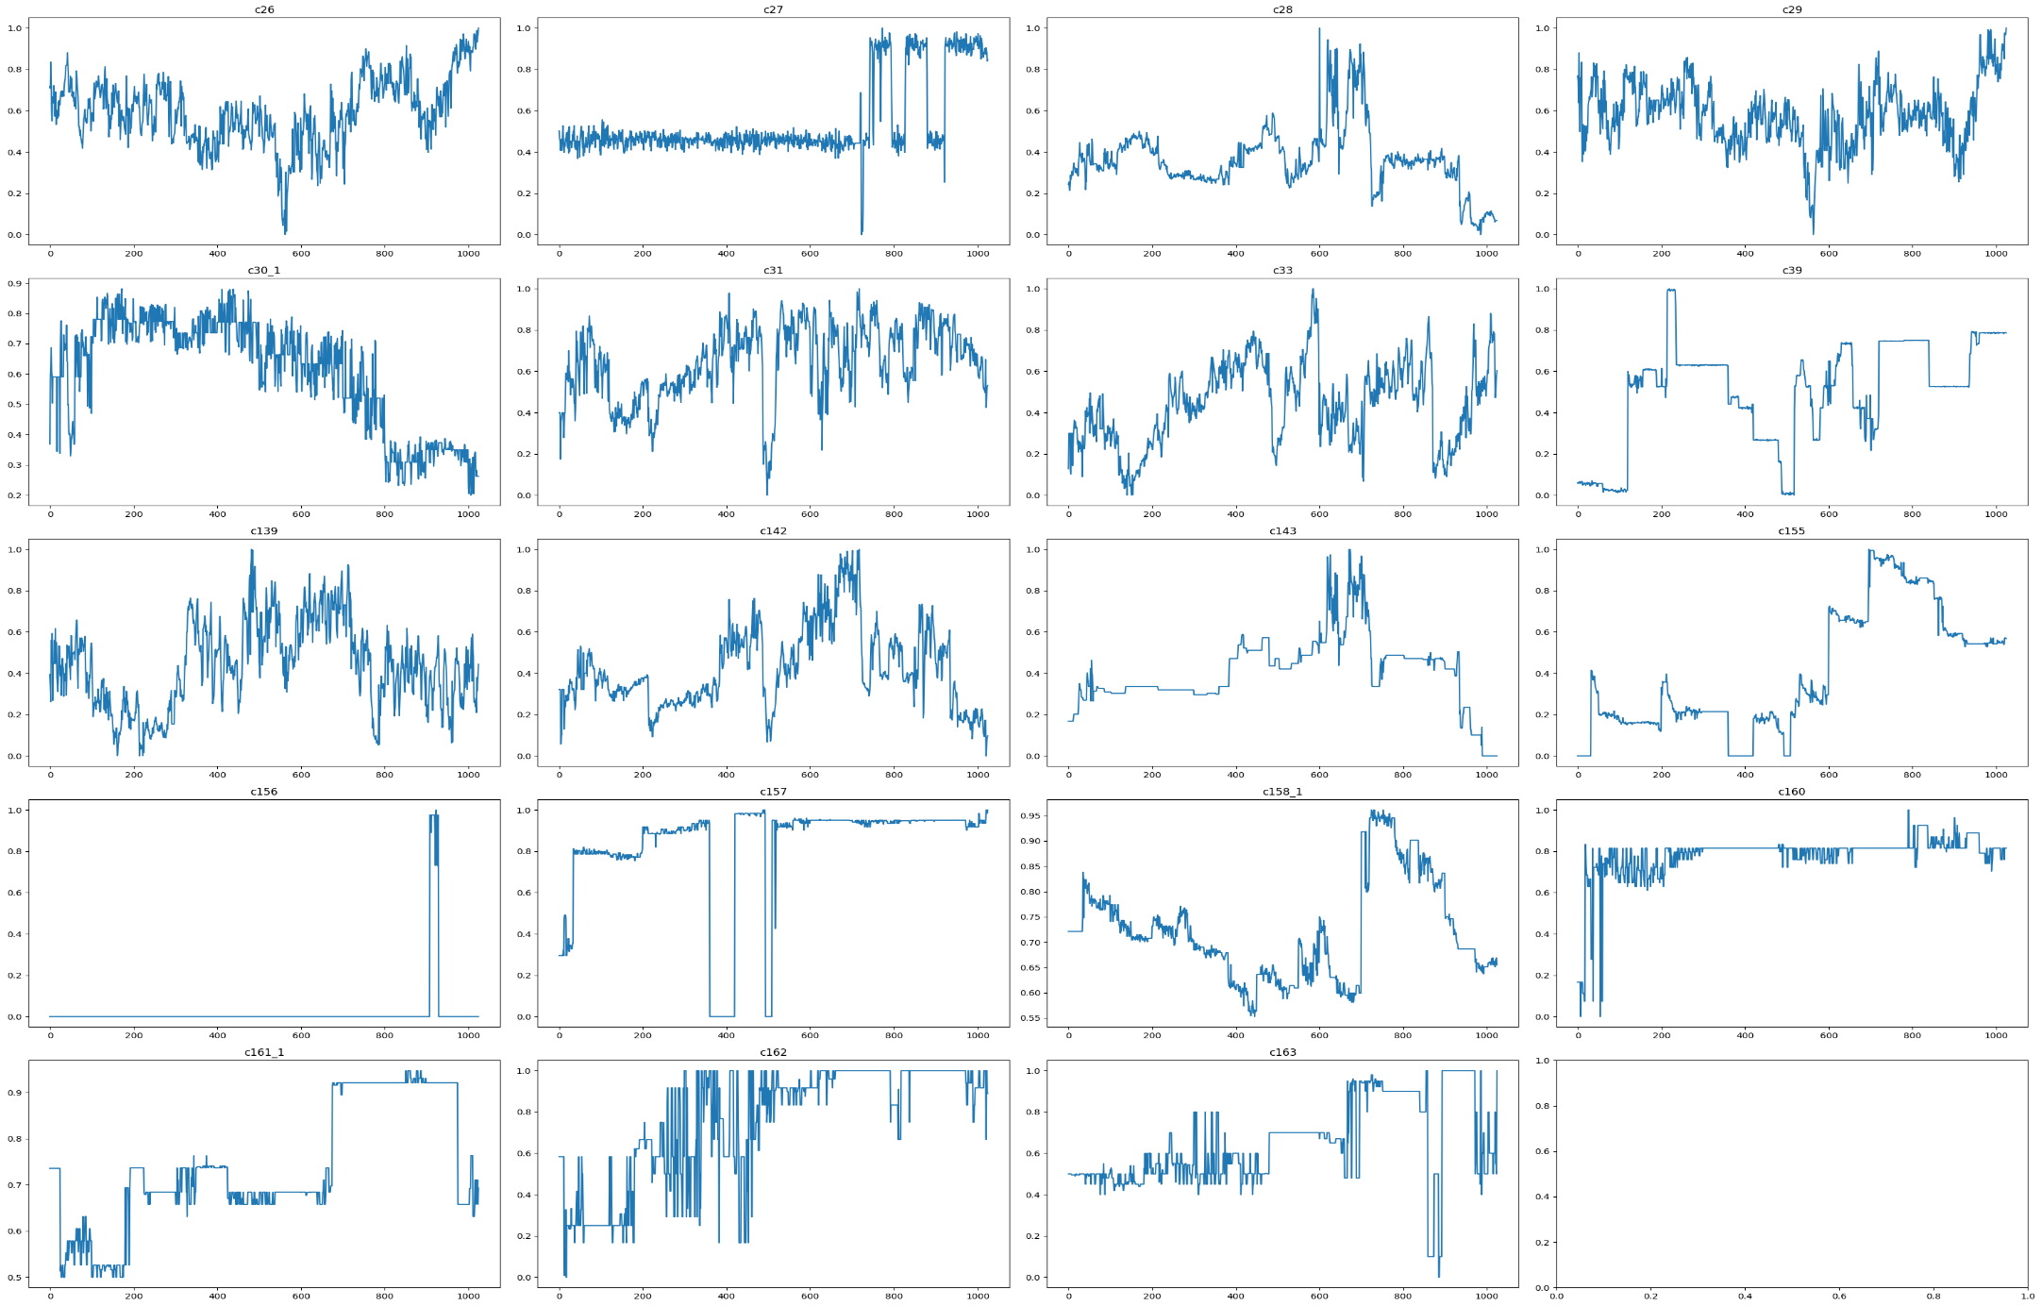
After removing the outliers also features are still very fluctuating and because of it our model is also capturing the errors accompanied with the features. Therefore it would be better to use weighted mean of features instead of using features directly.
Plot of Weighted means of those features
The results of linear regression models using the weighted means is shown in next slides.
Also as we have normalized the data after removing features with high p-value most significant features would be those who have higher magnitude of coefficient.
From the R-square value and the plots we can see that the C51-C52 and C53-C54 are related.
Plot of the controllable 19 features

Slide 13
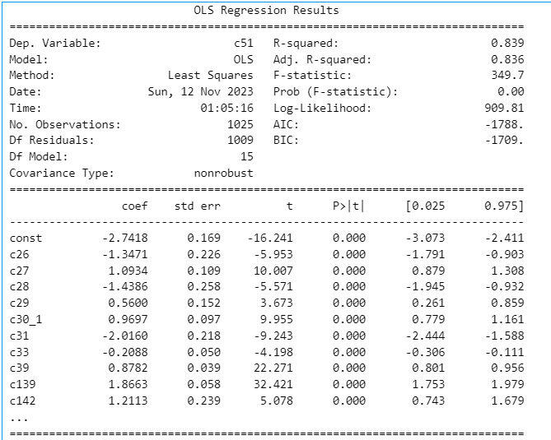
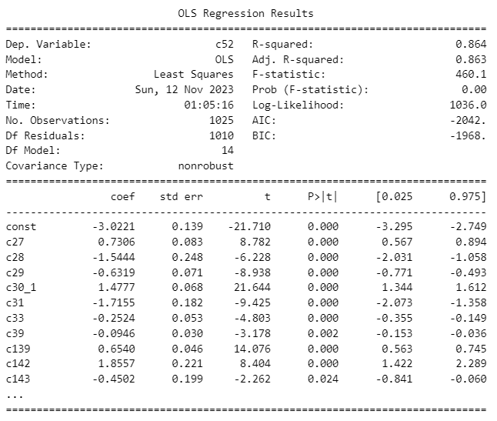
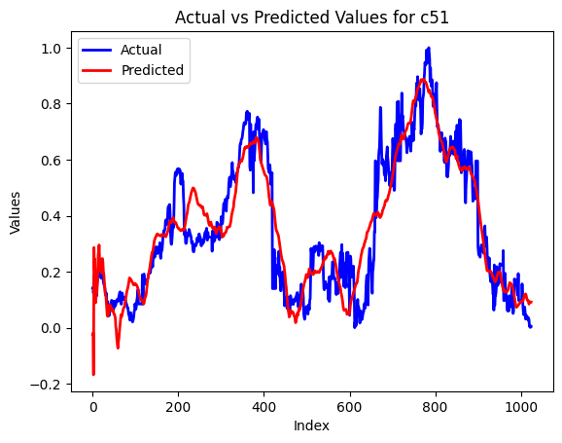
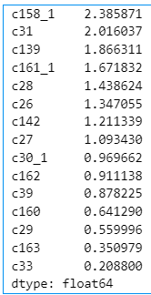
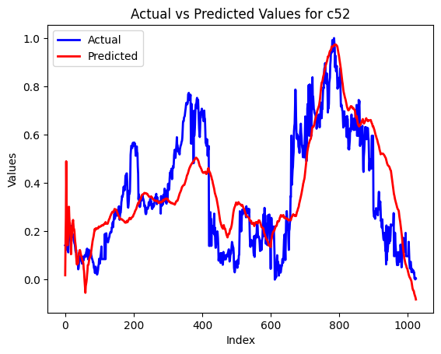
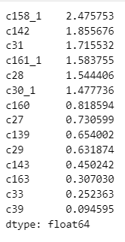
C51
C52
Most important features in descending order
Most important features in descending order

Slide 14
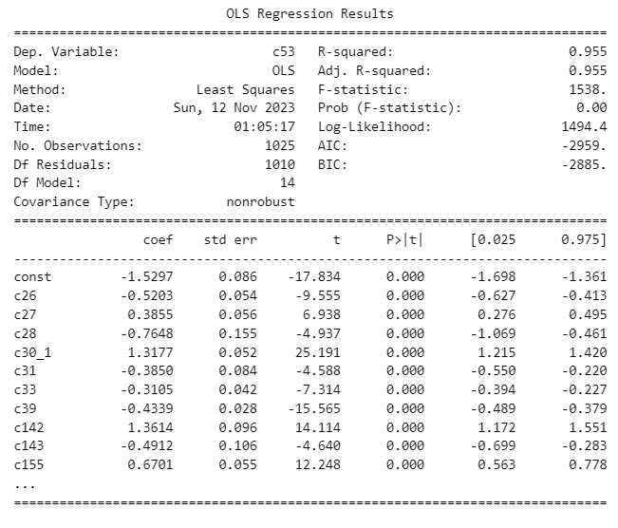
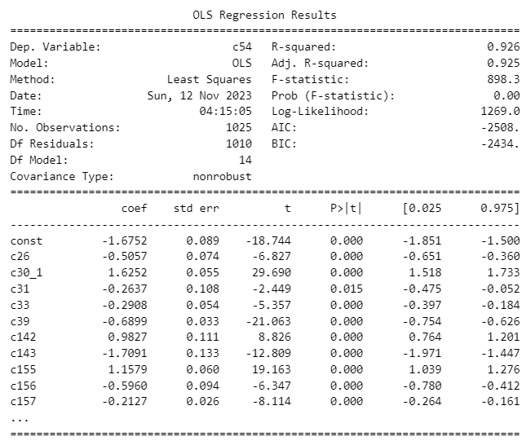
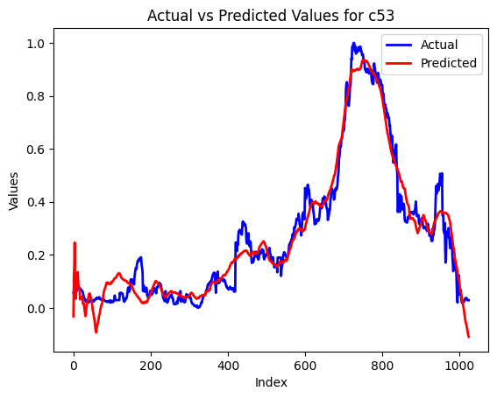
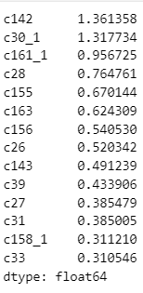
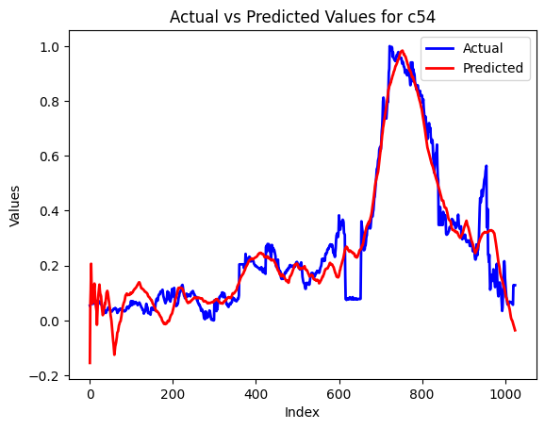
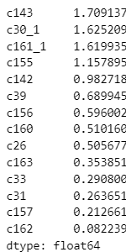
C53
C54
Most important features in descending order
Most important features in descending order

Slide 15
Task-2: Model on c241
While fitting the model we took c241 as the dependent variable and the remaining as independent variable except the timestamp column
We normalized independent features in our multiple linear regression model to neutralize the impact of varying scales, crucial for distance-based algorithms like linear regression
Backward feature engineering
We created a function to fit the initial model, calculated the maximum p-value for all features, and iteratively dropped features with p-values greater than 0.05 until none remained
Normalization
Result
We ran a code for checking the parameter having maximum beta coefficient magnitude value, as a result, we got c11 which contributes much while predicting c241
We trained the model on 80 % data and tested the trained model on the remaining 20% of data and as a result, we got the rsquare value for the trained model as 0.9753 and that for the test as 9.9732
Fitting the model
Fitting the model
As a result, we remained with only 65 features having a p-value less than 0.05

Slide 16
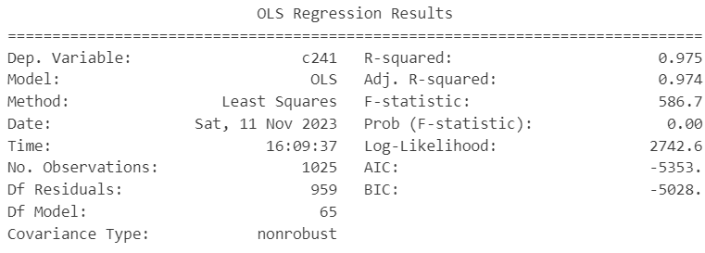

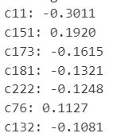
Result of Task-2
The coefficient corresponding to c11 has maximum magnitude

Slide 17
TASK 3
The minimum number of independent variables that can be used to only predict and not control c241 is 39 as per our analysis.
These variables are: ['c2', 'c7', 'c14', 'c24', 'c25', 'c36', 'c37', 'c42', 'c45', 'c60', 'c62', 'c79', 'c81', 'c82', 'c98', 'c110', 'c113', 'c123', 'c133', 'c137', 'c125', 'c132', 'c152', 'c168', 'c169', 'c170', 'c171', 'c177', 'c179', 'c184', 'c194', 'c213', 'c223', 'c224', 'c225', 'c230', 'c234', 'c235', 'c238']
Analysis –
Firstly, all the controllable parameters were dropped as per the conditions of the question, wherein we are asked just to predict c241
Then a correlation matrix is created which helps us predict the columns having a correlation greater than 0.6.
This threshold was chosen after experimentation with other values.
There was a trade-off between the quality of the model and reducing the number of features involved. Hence, the chosen threshold helps strike a balance.
A filtered data frame was created with all the columns having a correlation of less than 0.6 and relatively independent of each other
These columns are used to form a regression model.
The final model is obtained by improving the original model by deleting the insignificant columns (decided by p-values).

Slide 18
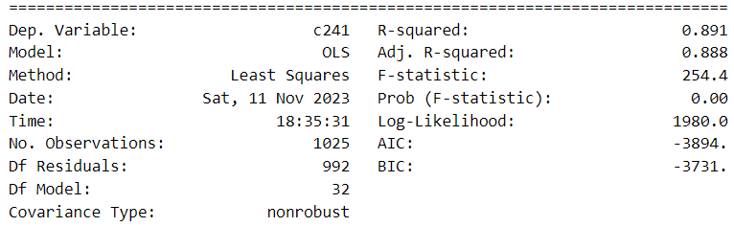
THE FINAL MODEL IN TASK 3
NOTE –
If we chose the threshold as 0.7, then R² = 0.91, but we would have ended up with 51 features, while we are looking for the minimum number of features.
If we chose the threshold as 0.55, then R² = 0.83, and number of features would have been 33. Hence there would have been significant degradation in the quality of model without much reduction in number of features.

